Slide 1
Impact-Induced Shock Metamorphism and Microbial Habitability in Coconino Sandstone
Austin Gadd - Northern Arizona University
How impacts shape microbial environments in planetary analogs

Slide 2
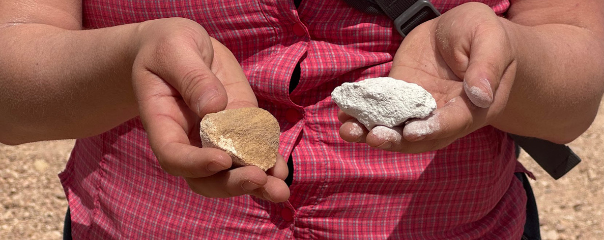
Research Question
  How does shock-metamorphism impacts microbial communities within variably shocked samples of Coconino Sandstone found at Barringer Crater.
(Barringer Crater Company, 2025)

Slide 3
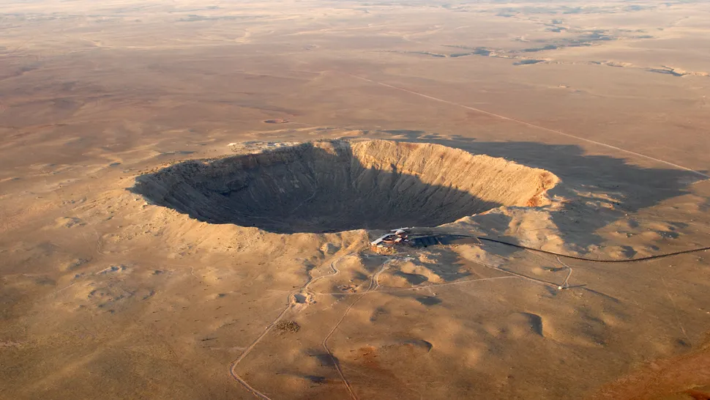
What is Barringer Crater?
  The Most Preserved Impact Crater on Earth
  50,000 Years Old
  Winslow, Arizona
  The first classified Meteorite Impact Site
  Comprised of three geologic layers
    Moenkopi Sandstone
    Kaibab Limestone
    Coconino Sandstone
(Image credit: StephanHoerold via Getty Images)

Slide 4
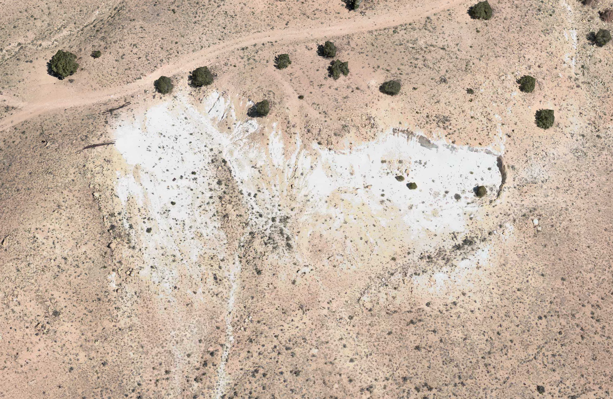
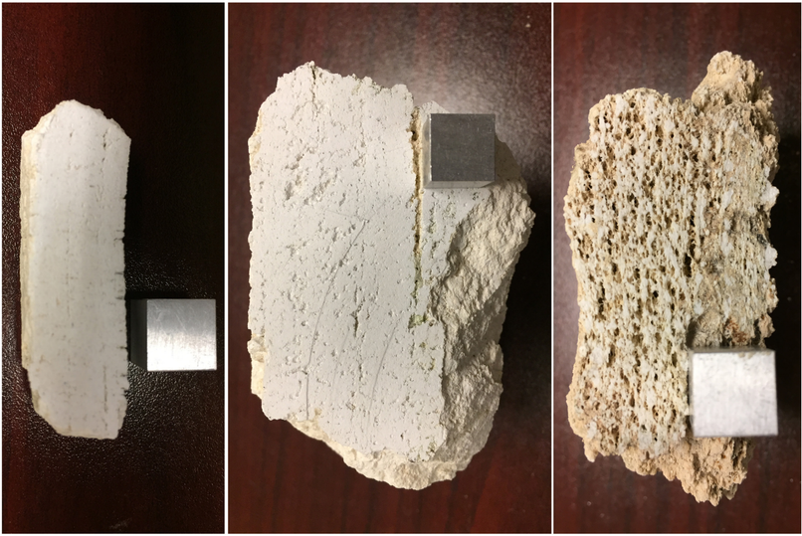
COconino Sandstone
  A prominent light colored formation composed of fine-grained sand
  The oldest of the geologic layers
  Was formed when Northern Arizona was covered by a sand dune field similar to the Modern Sahara. (Kring, 2017)
  The samples we collected consist of:
    Highly-Shocked Sample: Flour-like consistency of Coconino ejecta
    Less-Shocked Sample: Has preserved sedimentary bedding
(Kring, 2017)

Slide 5
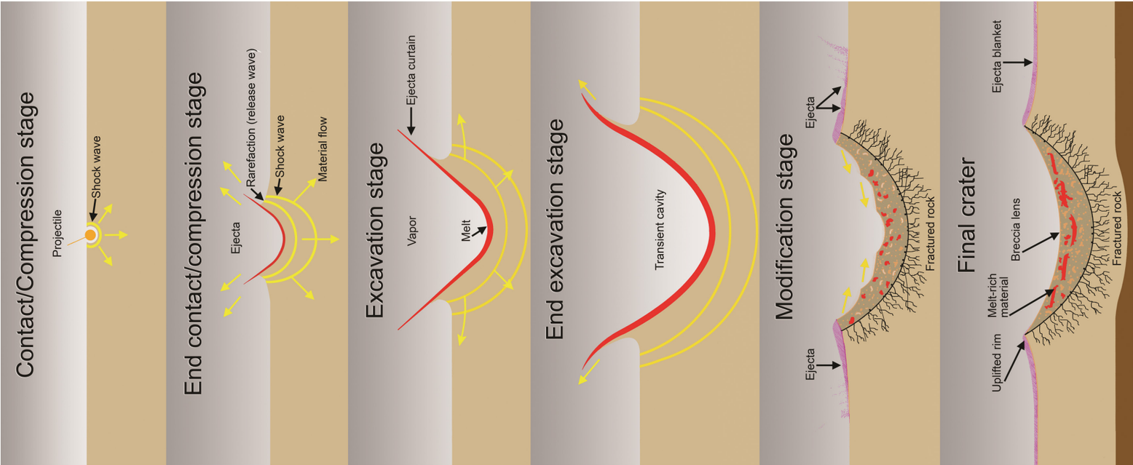
Shock Metamorphism
  Energy from the impact is converted into shockwaves
  The underlying rock is compressed, heated, and then deformed.
  Produces features you cannot get from normal geological processes.
(Kring, 2006)

Slide 6
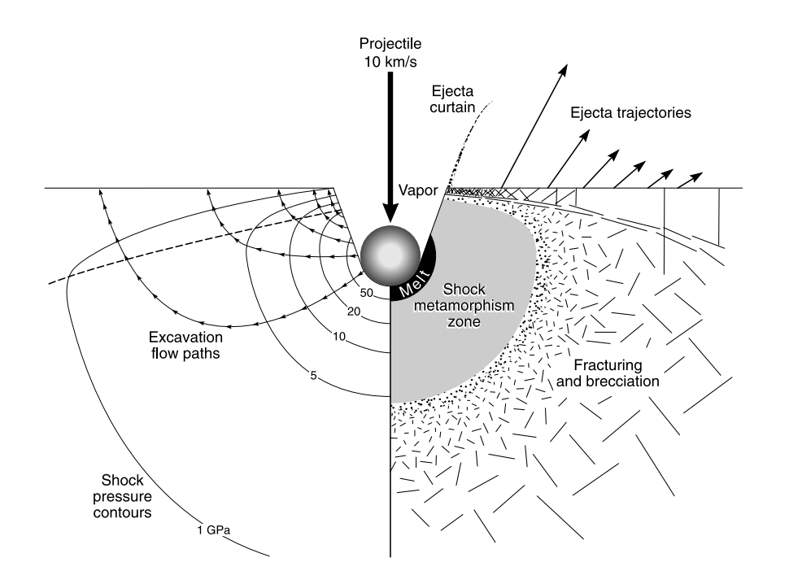
Shock Metamorphism
  Fracturing happens instantaneously and violently
  Often creates Breccia (broken rock fragments that got cemented together)
(French, 1998)

Slide 7
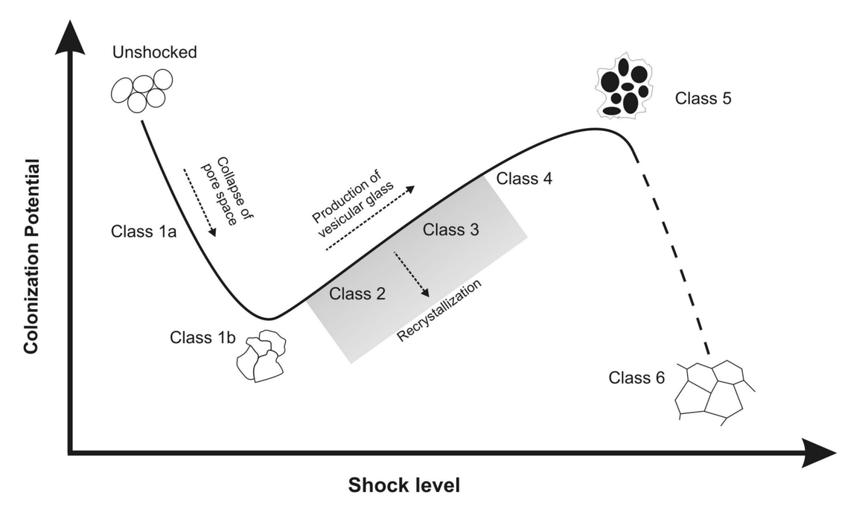
Impact Cratering and Life
  Impact cratering can increase and decrease porosity at the micron level.
    Can either increase or decrease potential habitability for microbes in a sample.
  Our less shocked sample lies around the recrystalization Classes, while our highly shocked sample is likely a Class 6 sample.
(Cockell et al., 2007)

Slide 8
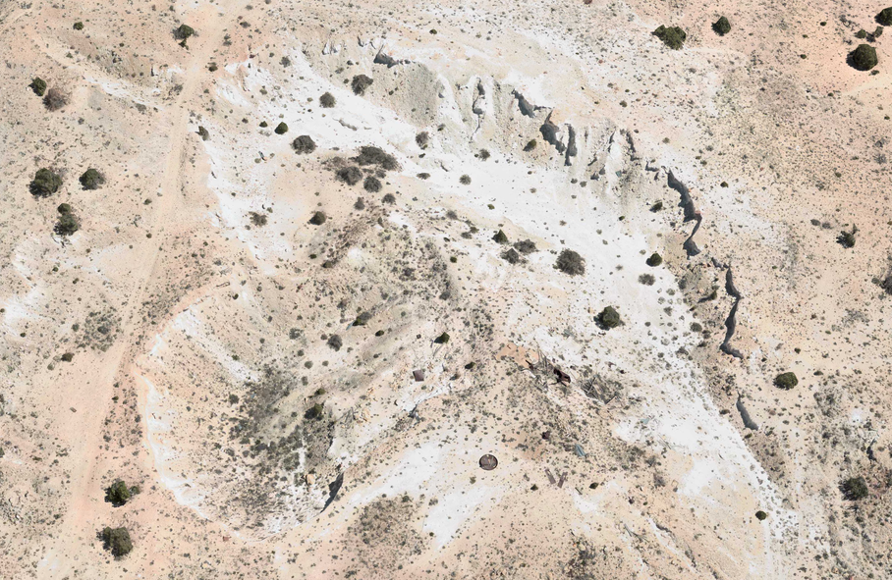
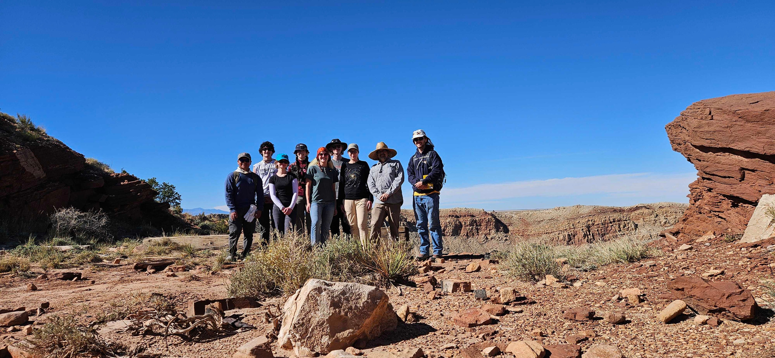
Field Sampling
Biological Sampling:
• Aseptically using gloves
• Sample tools sterilized with 10% bleach, and/or RNase and
70% ethanol
• Sterile Whirl-Pak bags or Falcon tubes stored at -80°C
Geological Sampling:
• Rock hammer & Chisel
• Stored in a labeled Ziplock bag after collection

Slide 9
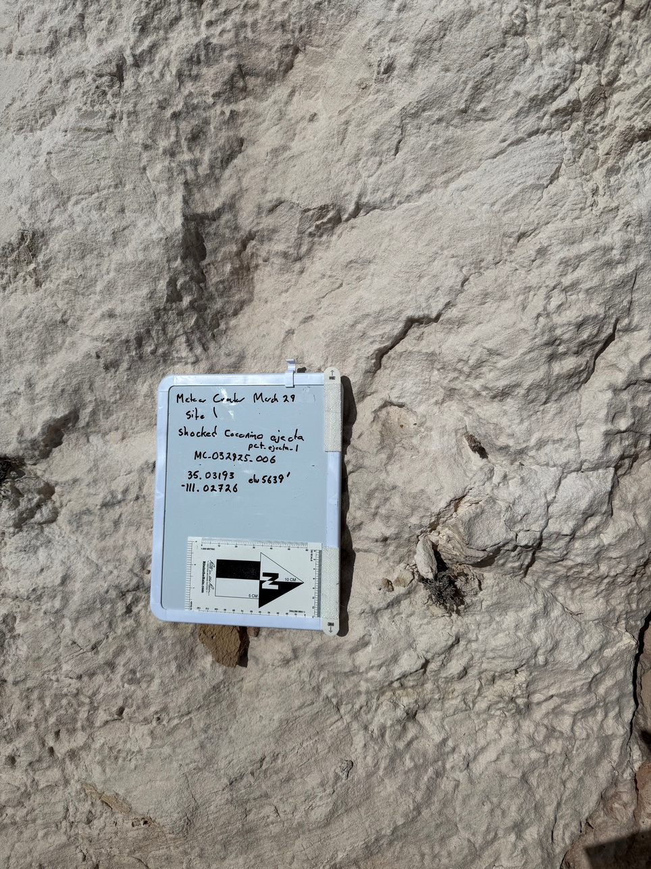
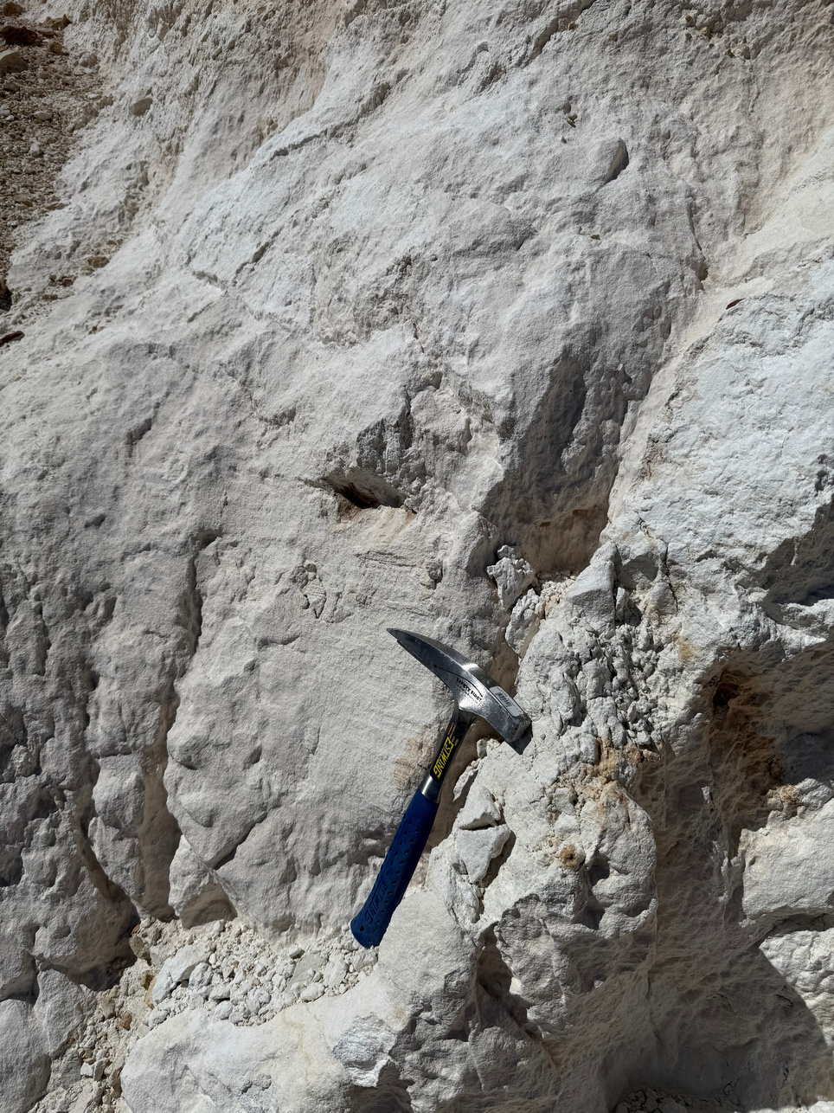
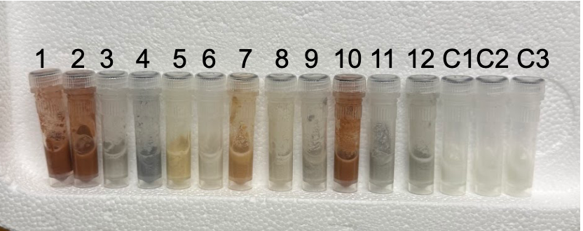

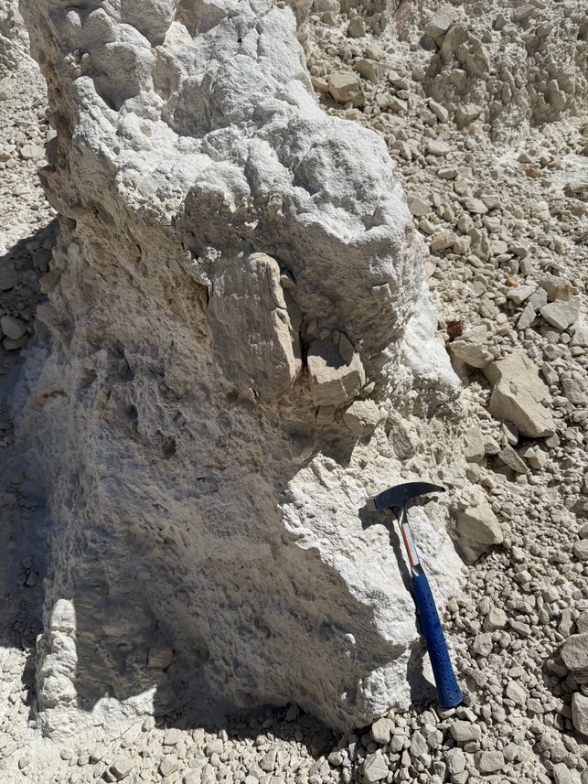
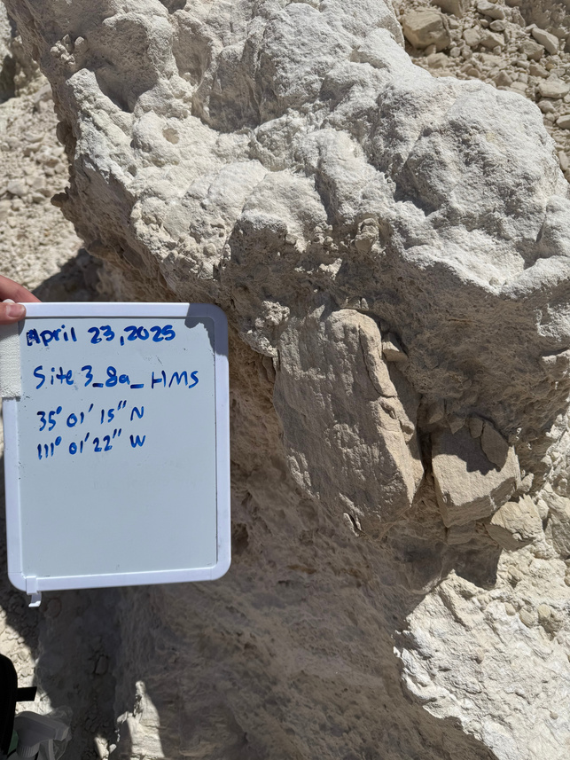
Sample Photos

Slide 10
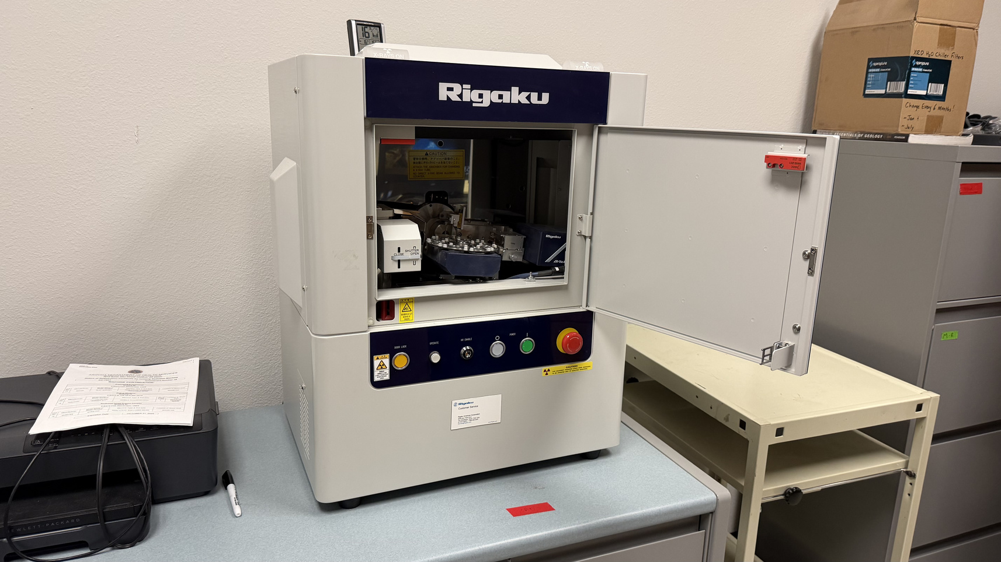
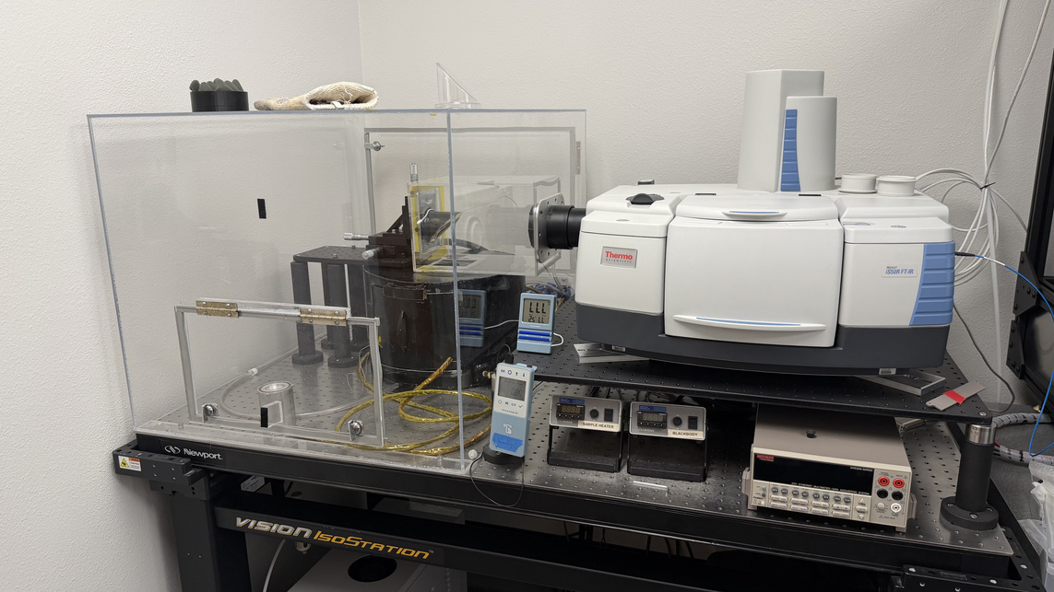
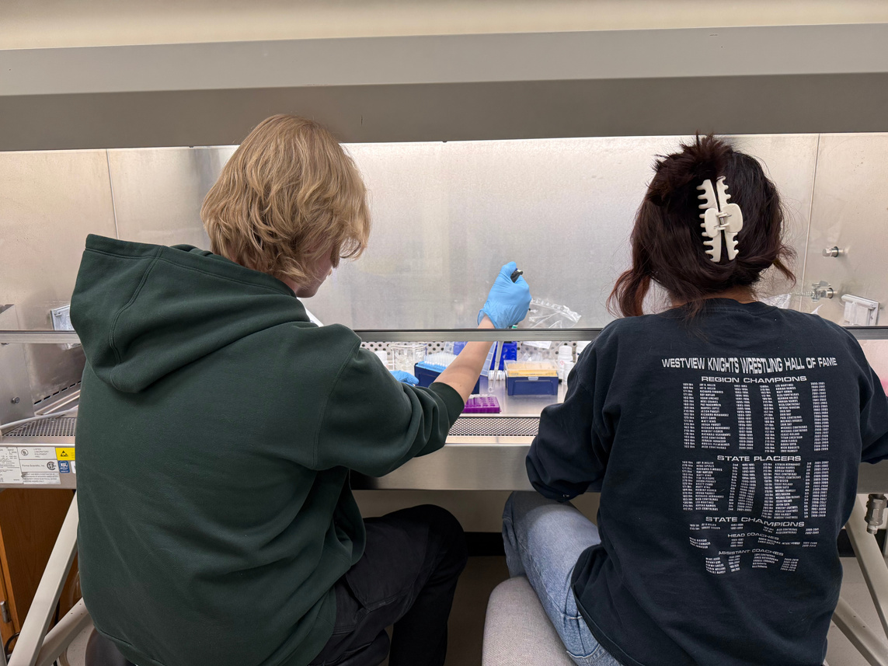
Methods
X-Ray Diffractometer (XRD)
  Tells us what crystalline phases are present in the sample and whether they’ve been altered by shock.
Fourier-Transform Infrared Spectroscopy (FTIR)
  Tells us how the structure of our sample has been chemically altered.
Modified version of the Qiagen DNAeasy PowerSoil PowerLyzer DNA extraction kit optimized for rock samples.
  DNA Extraction to sequence and see the difference in microbial communities

Slide 11
Anticipated results
  Moderately shocked sample of Coconino Sandstone will host greater microbial diversity
    Protects from UV Radiation
    Reduced Dessication
    Presereved pore structure

Slide 12
Why is this Important?
  Impact Craters may be prime targets for the detection of life on other terrestrial bodies!
  Knowing where habitability is the strongest post-impact, we will know where to look when exploring craters on other planetary bodies!

Slide 13




Acknowledgements!!
Thank you to Dr. Haley Sapers, Barringer Crater Co., and the Arizona Space Grant Consortium for this opportunity!

Slide 14
References
Cockell, C. S., Osinski, G., Sapers, H., Pontefract, A., & Parnell, J. (2007). Microbial life in impact craters. Current Issues in Molecular Biology, 38, 75–94. https://doi.org/10.21775/cimb.038.075
Kring, D. A. (2017). Guidebook to the geology of Barringer Meteorite Crater, Arizona (2nd ed.). Lunar and Planetary Institute. https://www.lpi.usra.edu/publications/books/barringer_crater_guidebook/index.shtml
Kring, D. A. (2006). Geological effects of impact cratering [Educational poster]. NASA / University of Arizona Space Imagery Center. https://sic.lpl.arizona.edu/sites/sic.lpl.arizona.edu/files/education/posters/geo_effects.jpg
French, B. M. (1998). Traces of catastrophe: A handbook of shock-metamorphic effects in terrestrial meteorite impact structures. Lunar and Planetary Institute. https://www.lpi.usra.edu/publications/books/CB-954/CB-954.intro.html
Barringer Crater Company. (2025). Coconino sandstone: Pre- and post-impact. https://barringercrater.com/blog/coconino-sandstone-pre-and-post-impact

